Slide 1
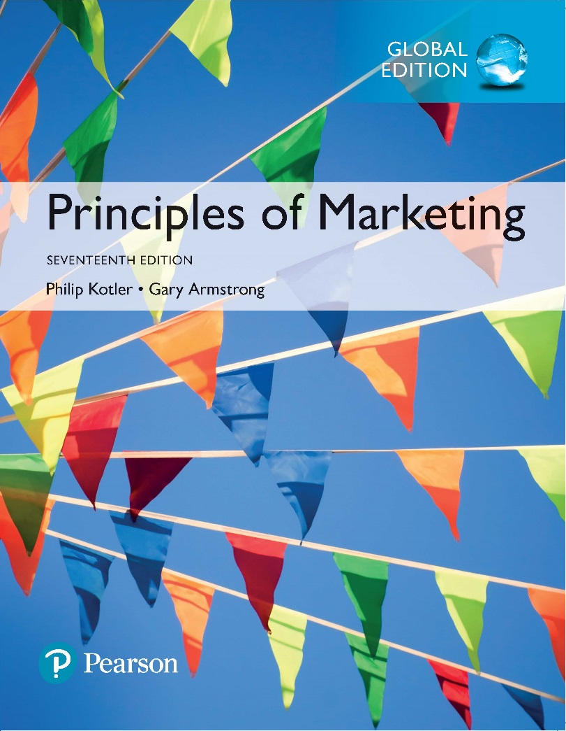
Principles of Marketing
Seventeenth Edition
Chapter 5
Consumer Markets and Buyer Behavior
Copyright © 2018 Pearson Education Ltd. All Rights Reserved.

Slide 2
Learning Objectives
5-1 Define the consumer market and construct a simple model of
consumer buyer behavior.
5-2 Name the four major factors that influence consumer buyer
behavior.
5-3 List and define the major types of buying decision behavior and
the stages in the buyer decision process.
5-4 Describe the adoption and diffusion process for new products.

Slide 3
Learning Objective 1
Define the consumer market and construct a simple model of consumer buyer behavior.

Slide 4
Consumer Markets and Buyer Behavior
Consumer buyer behavior is the buying behavior of final consumers—individuals and households that buy goods and services for personal consumption.
Consumer markets are made up of all the individuals and households that buy or acquire goods and services for personal consumption.
Notes:
Discussion Question
What have you recently purchased that cost over $100? Write down all the reasons you purchased this particular item.
Because students are all consumers—it is interesting to start the class with a discussion of products they have recently purchased. When you ask them why they purchased a particular item or product, you can bring them through many topics in this chapter including the characteristics that affect consumer behavior (cultural, social, personal, and psychological). You can also try to determine the process they went through including how and where they searched for information and how they evaluated their alternatives. Finally, ask them how they feel about their purchase (postpurchase behavior). This discussion will lead nicely to the next slide about the model of buyer behavior.
Consumers make many buying decisions every day, and the buying decision is the focal point of the marketer’s effort. Most large companies research consumer buying decisions in great detail to answer questions about what consumers buy, where they buy, how and how much they buy, when they buy, and why they buy. Marketers can study actual consumer purchases to find out what they buy, where, and how much. But learning about the whys of consumer buying behavior is not so easy—the answers are often locked deep within the consumer’s mind. Often, consumers themselves don’t know exactly what influences their purchases.

Slide 5
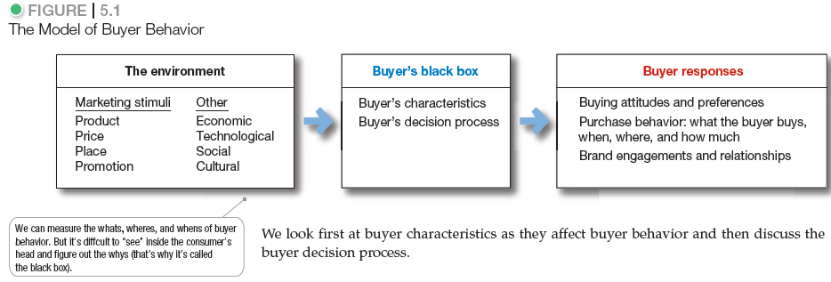
Consumer Markets and Buyer Behavior
Notes:
The central question for marketers is this: How do consumers respond to various marketing efforts the company might use? The starting point is the stimulus-response model of buyer behavior shown in Figure 5.1. This figure shows that marketing and other stimuli enter the consumer’s “black box” and produce certain responses. Marketers must figure out what is in the buyer’s black box.

Slide 6
Learning Objective 2
Name the four major factors that influence consumer buyer behavior.

Slide 7
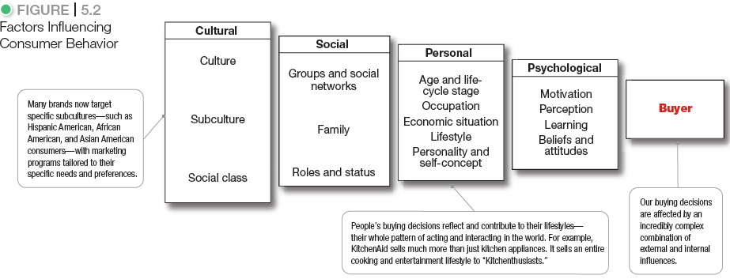
Characteristics Affecting Consumer Behavior
Notes:
Consumer purchases are influenced strongly by cultural, social, personal, and psychological characteristics, as shown in Figure 5.2. For the most part, marketers cannot control such factors, but they must take them into account.
Discussion Question
What factors influenced your decision to buy the specific smart phone you have?

Slide 8
Characteristics Affecting Consumer Behavior
Cultural Factors
Culture is the set of basic values, perceptions, wants, and behaviors learned by a member of society from family and other important institutions.
Notes:
Cultural factors exert a broad and deep influence on consumer behavior. Marketers need to understand the role played by the buyer’s culture, subculture, and social class.
Marketers are always trying to spot cultural shifts so as to discover new products that might be wanted. For example, the cultural shift toward greater concern about health and fitness has created a huge industry for health-and-fitness services, exercise equipment and clothing, organic foods, and a variety of diets.

Slide 9
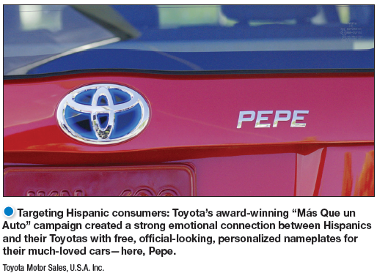
Characteristics Affecting Consumer Behavior
Cultural Factors
Subcultures are groups of people within a culture with shared value systems based on common life experiences and situations.
Notes:
Subcultures include nationalities, religions, racial groups, and geographic regions.
Discussion Question
What subculture do you belong to? How does this influence you as a consumer?
Although Hispanic consumers share many characteristics and behaviors with the mainstream buying public, there are also distinct differences. They tend to be deeply family oriented and make shopping a family affair. Older, first-generation Hispanic consumers tend to be very brand loyal and to favor brands and sellers who show special interest in them. Younger Hispanics, however, have shown increasing price sensitivity in recent years and a willingness to switch to store brands.
Within the Hispanic market, there exist many distinct subsegments based on nationality, age, income, and other factors. A company’s product or message may be more relevant to one nationality over another, such as Mexicans, Costa Ricans, Argentineans, or Cubans. Companies must also vary their pitches across different Hispanic economic segments.
The U.S. African American population is growing in affluence and sophistication. In recent years, many companies have developed special products, appeals, and marketing programs for African American consumers. For example, Cover Girl's Queen Latifah line is specially formulated “to celebrate the beauty of women of color.”
Asian American consumers are the most affluent U.S. demographic segment. They now number more than 18 million, with annual buying power expected to approach $1 billion by 2017. Asian Americans are the second-fastest-growing subsegment after Hispanic Americans. And like Hispanic Americans, they are a diverse group that speaks many different languages. As a group, Asian consumers shop frequently and are the most brand conscious of all the ethnic groups. They can be fiercely brand loyal. As a result, many firms now target the Asian American market.
Cross-cultural marketing is the practice of including ethnic themes and cross-cultural perspectives within mainstream marketing. Cross-cultural marketing appeals to consumer similarities across subcultures rather than differences. Many marketers are finding that insights gleaned from ethnic consumers can influence their broader markets.

Slide 10
Characteristics Affecting Consumer Behavior
Cultural Factors
Social classes are society’s relatively permanent and ordered divisions whose members share similar values, interests, and behaviors.
Measured as a combination of occupation, income, education, wealth, and other variables
Major American Social Classes
    Upper Class
    Middle Class
    Working Class
    Lower Class
Notes:
In some social systems, members of different classes are reared for certain roles and cannot change their social positions.
In the United States, however, the lines between social classes are not fixed and rigid; people can move to a higher social class or drop into a lower one.

Slide 11
Characteristics Affecting Consumer Behavior
Social Factors
Groups and Social Networks
Membership Groups
Groups with direct influence and to which a person belongs
Aspirational Groups
Groups an individual wishes to belong to
Reference Groups
Groups that form a comparison or reference in forming attitudes or behavior
Notes:
Discussion Question
What groups are you a member of and what are your aspirational groups? How does this influence you as a consumers?
Marketers try to identify the reference groups of their target markets. Reference groups expose a person to new behaviors and lifestyles, influence the person’s attitudes and self-concept, and create pressures to conform that may affect the person’s product and brand choices. The importance of group influence varies across products and brands. It tends to be strongest when the product is visible to others whom the buyer respects.

Slide 12
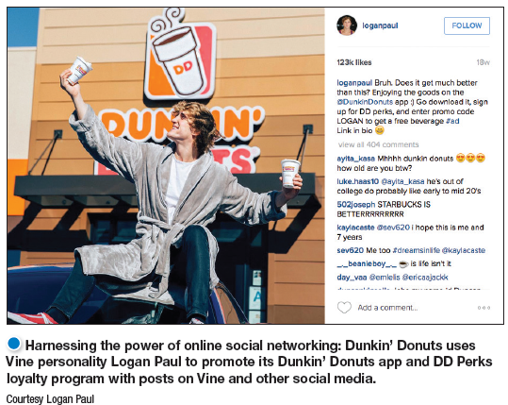
Characteristics Affecting Consumer Behavior
Groups and Social Networks
Online social networks
Buzz marketing
Social media sites
Virtual worlds
Word of mouth
Opinion leaders
Notes:
Using social networks: Timberland has created an extensive online community that connects like-minded “Earthkeepers” with each other and the brand through several web sites, a Facebook page, a YouTube channel, a Bootmakers Blog, an e-mail newsletter, and several Twitter feeds.
Discussion Question
How can marketers use these networks?
This slide should provide a lively discussion for students because they all are users of social networks. Ask students for examples they have seen or experienced. Then be sure to ask if they think the marketing efforts were effective for the marketer and why? The text gives many examples.
Social networking media range from blogs (Gizmodo, Zenhabits) and message boards (Craigslist) to social networking websites (Facebook, Twitter, and Foursquare) and virtual worlds (Second Life). This new form of consumer-to-consumer and business-to-consumer dialog has big implications for marketers. Marketers are working to harness the power of these new online social networks and other “word-of-Web” opportunities to promote their products and build closer customer relationships.
Word-of-mouth influence can have a powerful impact on consumer buying behavior. The personal words and recommendations of trusted friends, associates, and other consumers tend to be more credible than those coming from commercial sources, such as advertisements or salespeople.
Marketers of brands subjected to strong group influence must figure out how to reach opinion leaders—people within a reference group who, because of special skills, knowledge, personality, or other characteristics, exert social influence on others. Some experts call this group the influentials or leading adopters. When these influentials talk, consumers listen.
Buzz marketing involves enlisting or even creating opinion leaders to serve as “brand ambassadors” who spread the word about a company’s products. Many companies are now turning everyday customers into brand evangelists.

Slide 13
Characteristics Affecting Consumer Behavior
Social Factors
Family is the most important consumer-buying organization in society.
Role and status can be defined by a person’s position in a group.
Notes:
Discussion Question
What brands do you purchase because it is what your parents used? Why do you think this occurs?
Family members can strongly influence buyer behavior. The family is the most important consumer buying organization in society, and it has been researched extensively. Marketers are interested in the roles and influence of the husband, wife, and children on the purchase of different products and services.
A person belongs to many groups—family, clubs, organizations, and online communities. The person’s position in each group can be defined in terms of both role and status. A role consists of the activities people are expected to perform according to the people around them. Each role carries a status reflecting the general esteem given to it by society.
People usually choose products appropriate to their roles and status. Consider the various roles a working mother plays. In her company, she may play the role of a brand manager; in her family, she plays the role of wife and mother; at her favorite sporting events, she plays the role of avid fan. As a brand manager, she will buy the kind of clothing that reflects her role and status in her company. At the game, she may wear clothing supporting her favorite team.

Slide 14
Characteristics Affecting Consumer Behavior
Personal Factors
Age and life-cycle stage
Notes:
A buyer’s decisions also are influenced by personal characteristics such as the buyer’s age and life-cycle stage, occupation, economic situation, lifestyle, and personality and self-concept.
People change the goods and services they buy over their lifetimes. Marketers often define their target markets in terms of life-cycle stage and develop appropriate products and marketing plans for each stage.
One of the leading life-stage segmentation systems is the Nielsen PRIZM Lifestage Groups system. PRIZM classifications consider a host of demographic factors such as age, education, income, occupation, family composition, ethnicity, and housing; and behavioral and lifestyle factors, such as purchases, free-time activities, and media preferences.
The major PRIZM Lifestage Groups carry names such as “Striving Singles,” “Young Achievers,” “Mainstream Families,” “Midlife Success,” “Affluent Empty Nests,” “Cautious Couples,” and “Sustaining Seniors.” The “Young Achievers” group includes seven subsegments, with names like “Young Digerati,” “Bohemian Mix,” and “Young Influentials.”

Slide 15
Characteristics Affecting Consumer Behavior
Personal Factors
Occupation affects the goods and services bought by consumers.
Economic situations include trends in:
Personal income
Savings
Interest rates
Spending
Notes:
Discussion Question
Ask the students how their occupations and economic situations affect the goods and services they buy.
Marketers try to identify the occupational groups that have an above-average interest in their products and services. A company can even specialize in making products needed by a given occupational group.
A person’s economic situation will affect his or her store and product choices. In today’s more frugal times, most companies have taken steps to redesign, reposition, and reprice their products and services. For example, upscale discounter Target has put more emphasis on the “Pay less” side of its “Expect more. Pay less.” positioning promise.

Slide 16
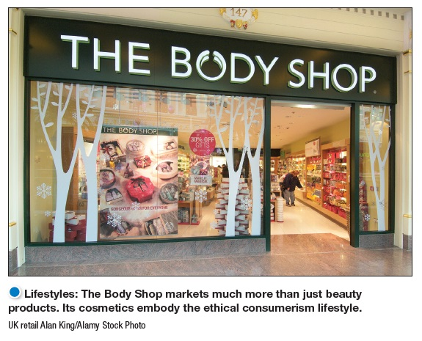
Characteristics Affecting Consumer Behavior
Personal Factors
Lifestyle is a person’s pattern of living as expressed in his or her psychographics.
Notes:
Lifestyles: KitchenAid sells much more than just high performance kitchen appliances. It sells an entire cooking and entertainment lifestyle to “Kitchenthusiasts.”
Discussion Question
What categories of products seem to be targeted to consumer’s lifestyles?
Students will realize that many products including cars, food, cosmetics, and shampoo appeal to consumer lifestyles.
When used carefully, the lifestyle concept can help marketers understand changing consumer values and how they affect buyer behavior. Consumers don’t just buy products; they buy the values and lifestyles those products represent.
Psychographics measure a consumer’s AIOs (activities, interests, opinions) to capture information about a person’s pattern of acting and interacting in the environment.
Marketers look for lifestyle segments with needs that can be served through special products or marketing approaches. Such segments might be defined by anything from family characteristics or outdoor interests to pet ownership.

Slide 17

Characteristics Affecting
Consumer Behavior
Personal Factors
Personality refers to the unique psychological characteristics that distinguish a person or group.
Notes:
Brand personality: Customers are likely to choose brands with personalities that match their own. JetBlue projects a “human” personality. It’s been “inspiring humanity since 2000.”
Personality is usually described in terms of traits such as self-confidence, dominance, sociability, autonomy, defensiveness, adaptability, and aggressiveness. Personality can be useful in analyzing consumer behavior for certain product or brand choices.
The idea is that brands also have personalities, and consumers are likely to choose brands with personalities that match their own. A brand personality is the specific mix of human traits that may be attributed to a particular brand.

Slide 18
Characteristics Affecting Consumer Behavior
Brand Personality Traits
Sincerity
Excitement
Sophistication
Ruggedness
Competence
Notes:
It is interesting to talk about brand personalities and ask students the personality of several brands.
A brand personality is the specific mix of human traits that may be attributed to a particular brand.
This slide shows five brand personality traits
1. Sincerity (down-to-earth, honest, wholesome, and cheerful)
2. Excitement (daring, spirited, imaginative, and up-to-date)
3. Competence (reliable, intelligent, and successful)
4. Sophistication (upper class and charming)
5. Ruggedness (outdoorsy and tough)
Each person’s distinct personality influences his or her buying behavior. Personality refers to the unique psychological characteristics that distinguish a person or group. Personality can be useful in analyzing consumer behavior for certain product or brand choices.
The idea is that brands also have personalities, and consumers are likely to choose brands with personalities that match their own.

Slide 19
Developing Marketing Information
Psychological Factors
Motivation
Perception
Learning
Beliefs and attitudes
Notes:
The following slides will discuss these psychological factors in detail.
Consider the impact of the advertisement shown in the slide on one of these factors:
Beliefs and Attitudes are difficult to change; however, the Vidalia Onion Committee’s award-winning Ogres and Onions campaign made believers of children and their delighted parents. Sales of bagged Vidalia onions shot up 30 percent.

Slide 20
Characteristics Affecting Consumer Behavior
Psychological Factors
A motive (or drive) is a need that is sufficiently pressing to direct the person to seek satisfaction of the need.
Motivation research refers to qualitative research designed to probe consumers’ hidden, subconscious motivations.
Notes:
Consumers often don’t know or can’t describe why they act as they do. Thus, motivation researchers use a variety of probing techniques to uncover underlying emotions and attitudes toward brands and buying situations.
Many companies employ teams of psychologists, anthropologists, and other social scientists to carry out motivation research. One ad agency routinely conducts one-on-one, therapy-like interviews to delve into the inner workings of consumers.
Another company asks consumers to describe their favorite brands as animals or cars (say, a Mercedes versus a Chevy) to assess the prestige associated with various brands. Still others rely on hypnosis, dream therapy, or soft lights and mood music to plumb the murky depths of consumer psyches.
Such projective techniques seem pretty goofy, and some marketers dismiss such motivation research as mumbo jumbo. But many marketers use such touchy-feely approaches, now sometimes called interpretive consumer research, to dig deeper into consumer psyches and develop better marketing strategies.

Slide 21
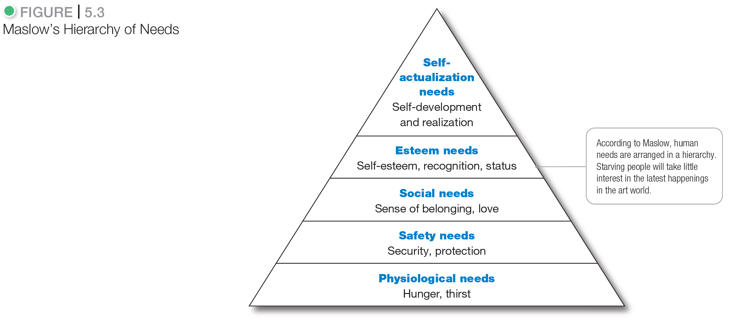
Developing Marketing Information
Notes:
Abraham Maslow sought to explain why people are driven by particular needs at particular times. Why does one person spend a lot of time and energy on personal safety and another on gaining the esteem of others? Maslow’s answer is that human needs are arranged in a hierarchy, as shown in Figure 5.3, from the most pressing at the bottom to the least pressing at the top.
A person tries to satisfy the most important need first. When that need is satisfied, it will stop being a motivator, and the person will then try to satisfy the next most important need.

Slide 22
Characteristics Affecting Consumer Behavior
Psychological Factors
Perception is the process by which people select, organize, and interpret information to form a meaningful picture of the world.
Perceptual Processes
Selective distortion
Selective retention
Selective attention
Notes:
Discussion Question
If you watched television last night, what ads do you remember seeing?
Probe to find out why students remember certain ads—was it that they broke through the clutter, that they saw them many times, or that they are in the market for that certain product?
A motivated person is ready to act. How the person acts is influenced by his or her own perception of the situation. All of us learn by the flow of information through our five senses: sight, hearing, smell, touch, and taste. However, each of us receives, organizes, and interprets this sensory information in an individual way.

Slide 23
Characteristics Affecting Consumer Behavior
Psychological Factors
Selective attention is the tendency for people to screen out most of the information to which they are exposed.
Selective distortion is the tendency for people to interpret information in a way that will support what they already believe.
Selective retention is the tendency to remember good points made about a brand they
Notes:
People can form different perceptions of the same stimulus because of three perceptual processes: selective attention, selective distortion, and selective retention. People are exposed to a great amount of stimuli every day. For example, people are exposed to an estimated 3,000 to 5,000 ad messages every day. It is impossible for a person to pay attention to all these stimuli.
Because of selective attention, distortion, and retention, marketers must work hard to get their messages through.

Slide 24
Characteristics Affecting Consumer Behavior
Psychological Factors
Learning is the change in an individual’s behavior arising from experience and occurs through the interplay of:
Drives
Stimuli
Cues
Responses
Reinforcement
Notes:
Learning theorists say that most human behavior is learned. Learning occurs through the interplay of drives, stimuli, cues, responses, and reinforcement.
The practical significance of learning theory for marketers is that they can build up demand for a product by associating it with strong drives, using motivating cues, and providing positive reinforcement.
A drive is a strong internal stimulus that calls for action. A drive becomes a motive when it is directed toward a particular stimulus object − a person’s drive for self-actualization might motivate him or her to look into buying a camera.
Cues are minor stimuli that determine when, where, and how the person responds. For example, the person might spot several camera brands in a shop window, hear of a special sale price, or discuss cameras with a friend. These are all cues that might influence a consumer’s response to his or her interest in buying the product.
Suppose the consumer buys a Nikon camera. If the experience is rewarding, the consumer will probably use the camera more and more, and his or her response will be reinforced. Then the next time he or she shops for a camera, or for binoculars or some similar product, the probability is greater that he or she will buy a Nikon product.

Slide 25
Characteristics Affecting Consumer Behavior
Psychological Factors
A belief is a descriptive thought that a person has about something based on:
  knowledge
  opinion
  faith
An attitude describes a person’s relatively consistent evaluations, feelings, and tendencies toward an object or idea.
Notes:
Discussion Question
Ask the students how a belief they hold influenced one of their purchase decisions.
Through doing and learning, people acquire beliefs and attitudes. These, in turn, influence their buying behavior.
Marketers are interested in the beliefs that people formulate about specific products and services because these beliefs make up product and brand images that affect buying behavior. If some of the beliefs are wrong and prevent purchase, the marketer will want to launch a campaign to correct them.

Slide 26
Learning Objective 3
List and define the major types of buying decision behavior and the stages in the buyer decision process.

Slide 27
Types of Buying Decision Behavior
Complex buying behavior
Dissonance-reducing buying behavior
Habitual buying behavior
Variety-seeking buying behavior
Notes:
Some purchases are simple and routine, even habitual. Others are far more complex—involving extensive information gathering and evaluation—and are subject to sometimes subtle influences. For example, think of all that goes into a new car buying decision.

Slide 28
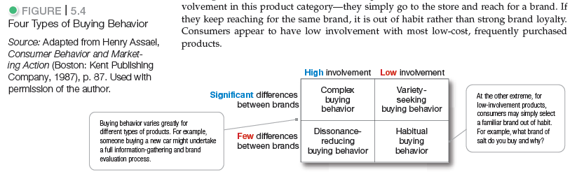
Types of Buying Decision Behavior
Notes:
Buying behavior differs greatly for a tube of toothpaste, a smartphone, financial services, and a new car. More complex decisions usually involve more buying participants and more buyer deliberation.
For example, someone buying a new car might undertake a full information-gathering and brand evaluation process. At the other extreme, for low-involvement products, consumers may simply select a familiar brand out of habit.
Discussion Question
What brand of toothpaste do you buy and why?
Figure 5.5 shows the types of consumer buying behavior based on the degree of buyer involvement and the degree of differences among brands.
Consumers undertake complex buying behavior when they are highly involved in a purchase and perceive significant differences among brands. Consumers may be highly involved when the product is expensive, risky, purchased infrequently, and highly self-expressive.
Dissonance-reducing buying behavior occurs when consumers are highly involved with an expensive, infrequent, or risky purchase but see little difference among brands.
Habitual buying behavior occurs under conditions of low-consumer involvement and little significant brand difference.
Consumers undertake variety-seeking buying behavior in situations characterized by low consumer involvement but significant perceived brand differences. In such cases, consumers often do a lot of brand switching.

Slide 29
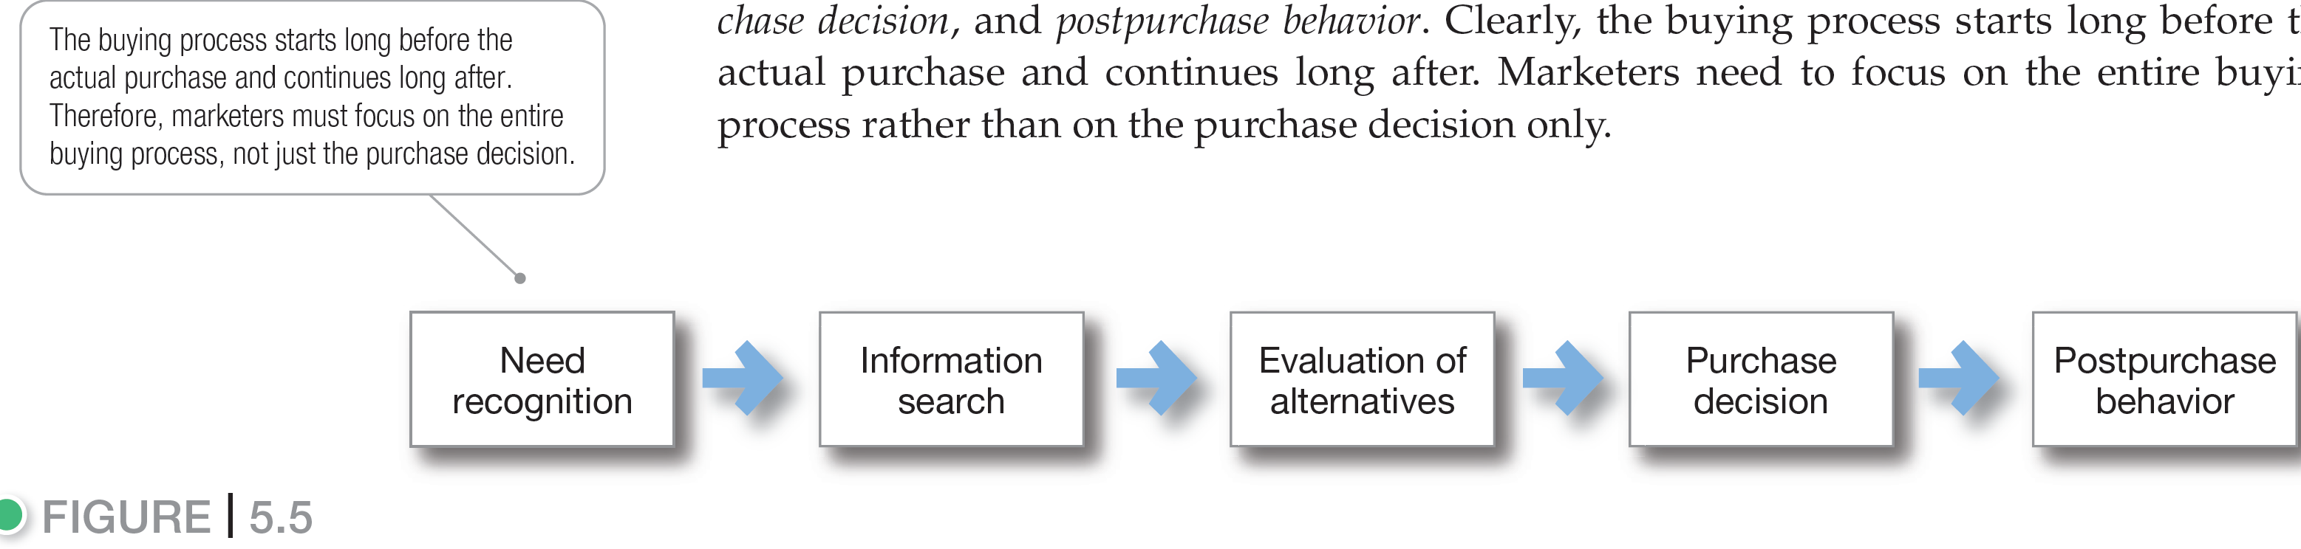
Figure 5.5 The Buyer Decision Process
Notes:
The buying process starts long before the actual purchase and continues long after. In fact, it might result in a decision not to buy. Therefore, marketers must focus on the entire buying process, not just the purchase decision.
Figure 5.5 suggests that consumers pass through all five stages with every purchase in a considered way. But buyers may pass quickly or slowly through the buying decision process. And in more routine purchases, consumers often skip or reverse some of the stages. Much depends on the nature of the buyer, the product, and the buying situation.

Slide 30
The Buyer Decision Process
Need Recognition
Need recognition is the first stage of the buyer decision process, in which the consumer recognizes a problem or need triggered by:
  Internal stimuli
  External stimuli
Notes:
Need Recognition
Need recognition may occur because of an advertisement or a discussion with a friend and get you thinking about buying a new car. This is the stage where the marketer should research consumers to find out what kinds of needs or problems arise, what brought them about, and how they led the consumer to this particular product.

Slide 31
The Buyer Decision Process
Information Search
Information search is the stage of the buyer decision process in which the consumer is motivated to search for more information.
Sources of information:
  Personal sources
  Commercial sources
  Public sources
  Experiential sources
Notes:
An interested consumer may or may not search for more information. If the consumer’s drive is strong and a satisfying product is near at hand, he or she is likely to buy it then. If not, the consumer may store the need in memory or undertake an information search related to the need.
For example, once you’ve decided you need a new car, at the least, you will probably pay more attention to car ads, cars owned by friends, and car conversations. Or you may actively search the Web, talk with friends, and gather information in other ways.
Traditionally, consumers have received the most information about a product from commercial sources—those controlled by the marketer. The most effective sources, however, tend to be personal. Commercial sources normally inform the buyer, but personal sources legitimize or evaluate products for the buyer.

Slide 32
The Buyer Decision Process
Evaluation of Alternatives
Alternative evaluation is the stage of the buyer decision process in which the consumer uses information to evaluate alternative brands in the choice set.
Notes:
Once consumers arrive at a set of final brand choices, marketers need to know how consumers process information to choose among alternative brands.
How consumers go about evaluating purchase alternatives depends on the individual consumer and the specific buying situation. The evaluation may involve careful calculations and logical thinking or little or no evaluating, buying on impulse, and relying on intuition.

Slide 33
The Buyer Decision Process
Purchase Decision
Purchase decision is the buyer’s decision about which brand to
purchase.
The purchase intention may not be the purchase decision due to:
  Attitudes of others
  Unexpected situational factors
Notes:
Once the evaluation is complete, the consumer’s purchase decision will generally be to buy the most preferred brand.
Preferences and even purchase intentions do not always result in an actual purchase.

Slide 34
The Buyer Decision Process
Postpurchase Behavior
Postpurchase behavior is the stage of the buyer decision process in which consumers take further action after purchase, based on their satisfaction or dissatisfaction.
Notes:
The marketer’s job does not end when the product is bought. After purchasing the product, the consumer will either be satisfied or dissatisfied and will engage in postpurchase behavior of interest to the marketer.
What determines whether the buyer is satisfied or dissatisfied with a purchase? The answer lies in the relationship between the consumer’s expectations and the product’s perceived performance.

Slide 35
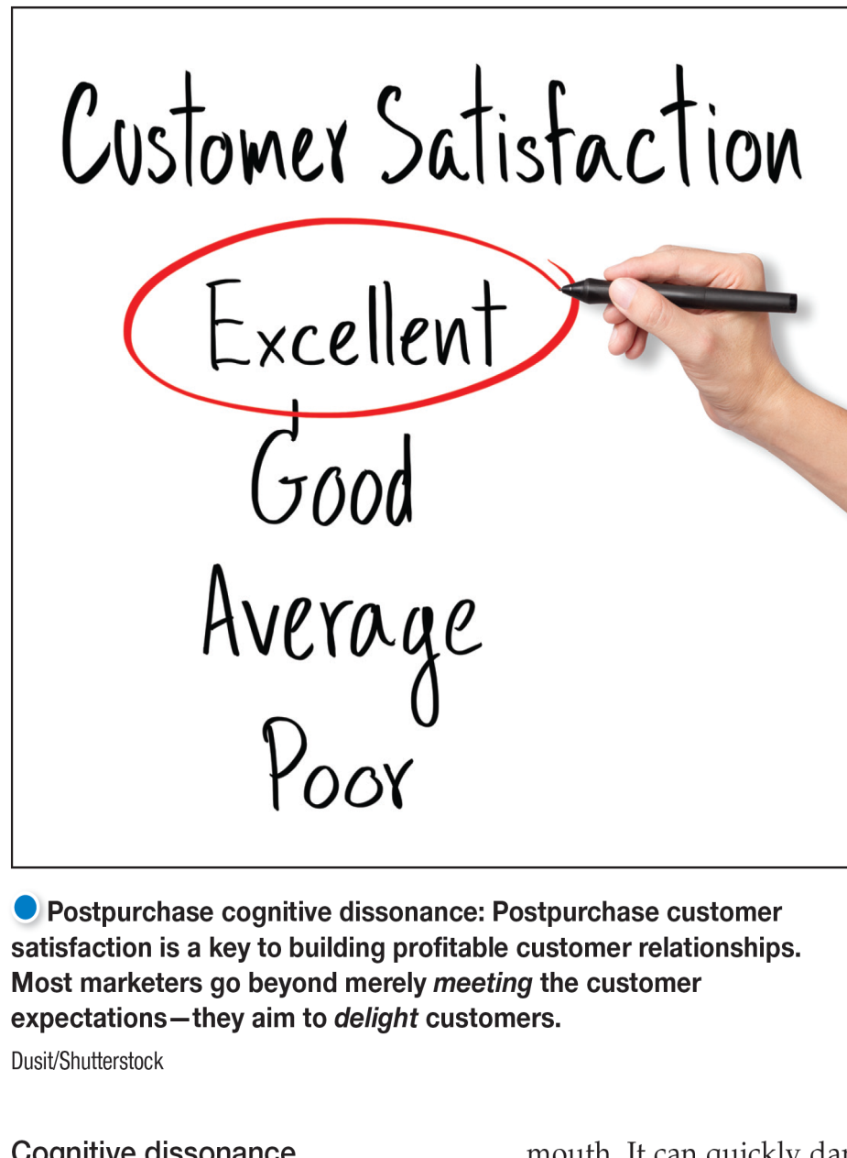
The Buyer Decision Process
Postpurchase Behavior
Cognitive dissonance is buyer discomfort caused by postpurchase conflict.
Notes:
Postpurchase cognitive dissonance: No matter what choice they make, consumers feel at least some postpurchase dissonance for every decision.
Almost all major purchases, however, result in cognitive dissonance, or discomfort caused by postpurchase conflict. After the purchase, consumers are satisfied with the benefits of the chosen brand and are glad to avoid the drawbacks of the brands not bought. So consumers feel uneasy about acquiring the drawbacks of the chosen brand and about losing the benefits of the brands not purchased.
Thus, consumers feel at least some postpurchase dissonance for every purchase and marketers should work to alleviate the discomfort by reinforcing the benefits of the chosen brand.

Slide 36
Learning Objective 4
Describe the adoption and diffusion process for new products.

Slide 37
The Buyer Decision Process for New Products
The adoption process is the mental process an individual goes through from first learning about an innovation to final regular use.
Stages in the adoption process include:
Awareness
Interest
Evaluation
Trial
Adoption
Notes:
A new product is a good, service, or idea that is perceived by some potential customers as new. It may have been around for a while, but our interest is in how consumers learn about products for the first time and make decisions on whether to adopt them.
Consumers go through five stages in the process of adopting a new product:
Awareness: The consumer becomes aware of the new product but lacks information about it.
Interest: The consumer seeks information about the new product.
Evaluation: The consumer considers whether trying the new product makes sense.
Trial: The consumer tries the new product on a small scale to improve his or her estimate of its value.
Adoption: The consumer decides to make full and regular use of the new product.
This model suggests that new-product marketers should think about how to help consumers move through these stages. For example,
For example, if consumers are not buying a new product because they do not perceive a need for it, marketing might launch advertising messages that trigger the need and show how the product solves customers’ problems.
If customers know about the product but are not buying because they hold unfavorable attitudes toward it, marketers must find ways to change either the product or consumer perceptions.

Slide 38
The Buyer Decision Process for New Products
Individual Differences in Innovativeness
Innovators
Early Adopters
Early Mainstream
Late Mainstream
Lagging Adopters
Notes:
People differ greatly in their readiness to try new products. In each product area, there are “consumption pioneers” and early adopters. Other individuals adopt new products much later. People can be classified into the adopter categories shown in Figure 5.7 on the next slide.

Slide 39
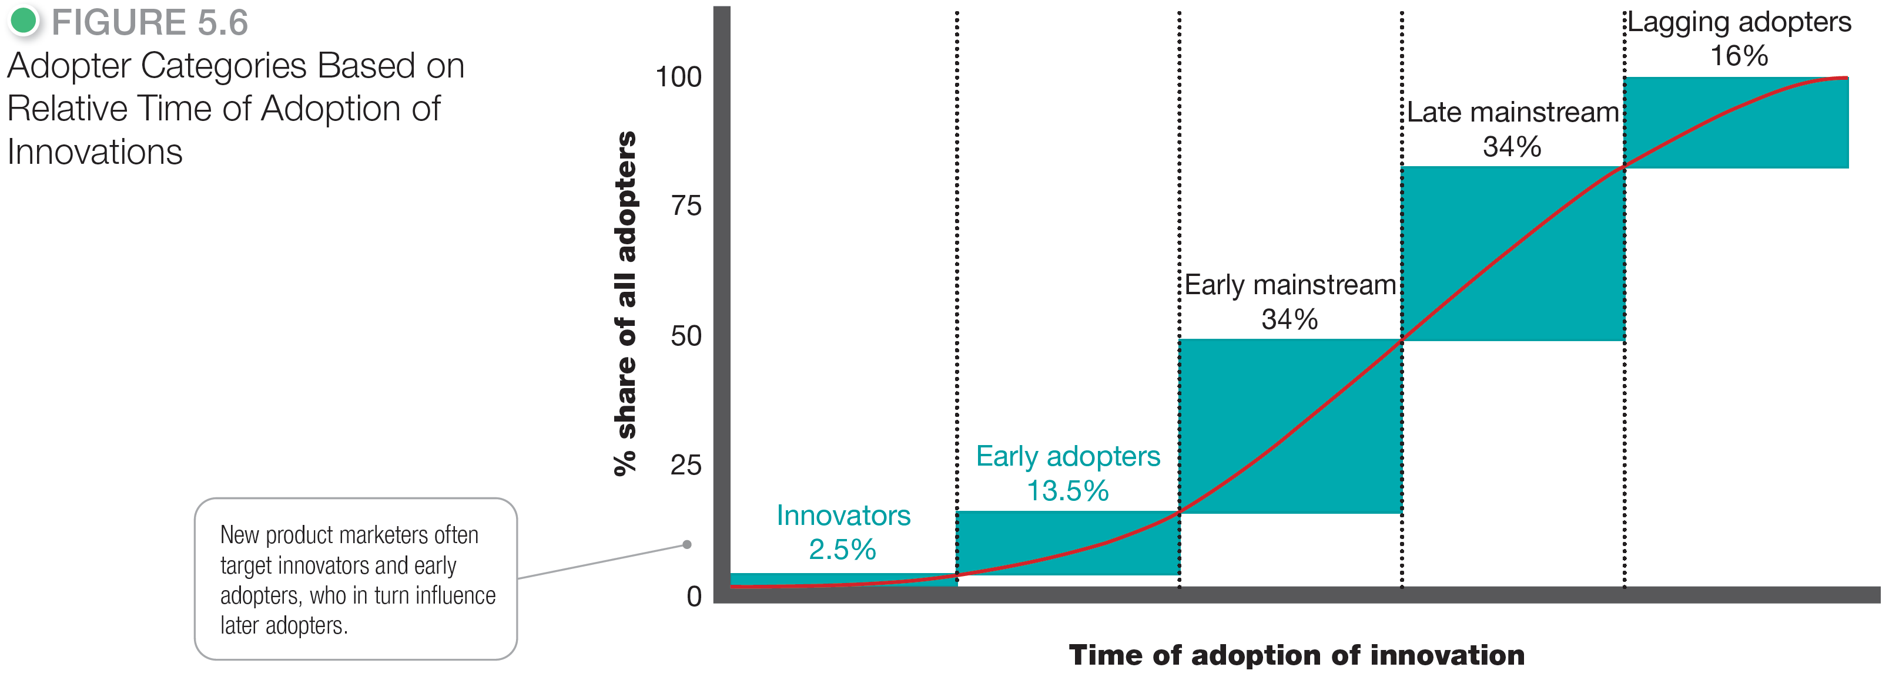
The Buyer Decision Process for New Products
Notes:
The five adopter groups shown in the slide have differing values.
Innovators are venturesome—they try new ideas at some risk.
Early adopters are guided by respect—they are opinion leaders in their communities and adopt new ideas early but carefully.
The early mainstream is deliberate—although they rarely are leaders, they adopt new ideas before the average person.
The late mainstream is skeptical—they adopt an innovation only after a majority of people have tried it.
Lagging adopters are tradition bound—they are suspicious of changes and adopt the innovation only when it has become something of a tradition itself.
This adopter classification suggests that an innovating firm should research the characteristics of innovators and early adopters in their product categories and direct initial marketing efforts toward them.

Slide 40
Analyzing and Using Marketing Information
Influence of Product Characteristics on Rate of Adoption
Relative advantage
Compatibility
Complexity
Divisibility
Communicability
Notes:
Five characteristics are especially important in influencing an innovation’s rate of adoption.
Relative advantage is the degree to which the innovation appears superior to existing products.
Compatibility is the degree to which the innovation fits the values and experiences of potential consumers.
Complexity is the degree to which the innovation is difficult to understand or use.
Divisibility is the degree to which the innovation may be tried on a limited basis.
Communicability is the degree to which the results of using the innovation can be observed or described to others.
Other characteristics influence the rate of adoption, such as initial and ongoing costs, risk and uncertainty, and social approval. The new-product marketer must research all these factors when developing the new product and its marketing program.

